Slide 1
Spark ML Summary

Slide 2
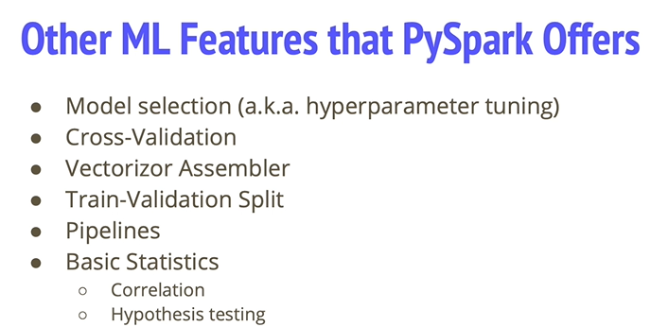
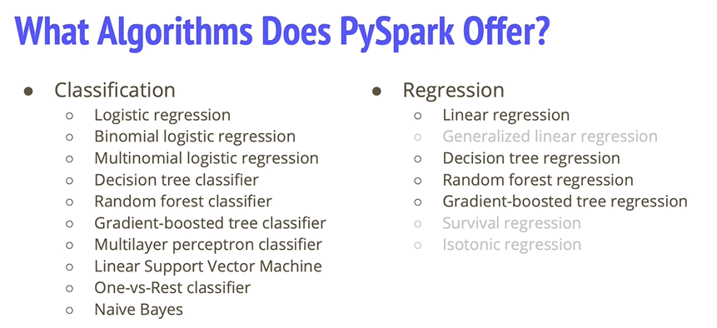
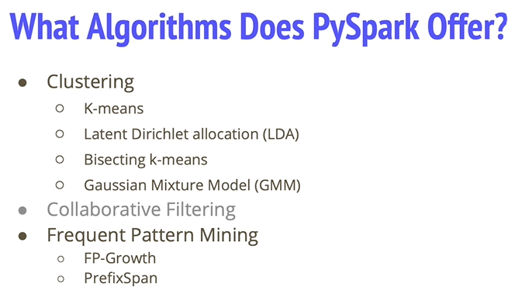

42. Intro to MLIB

Slide 3
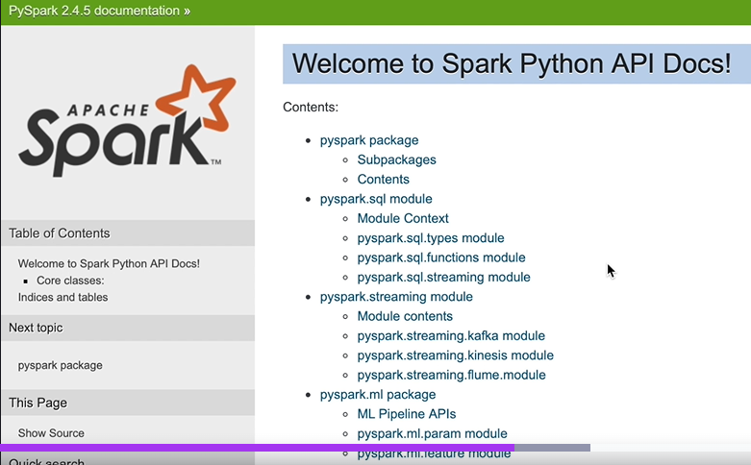
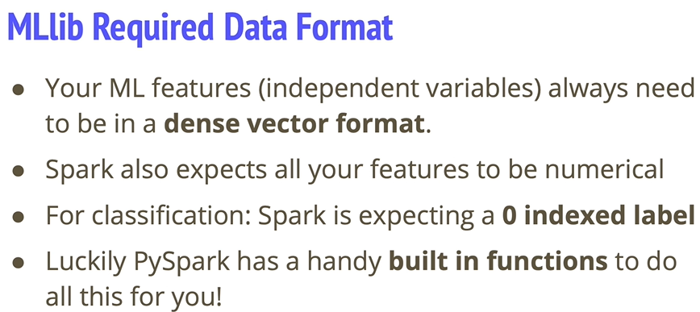
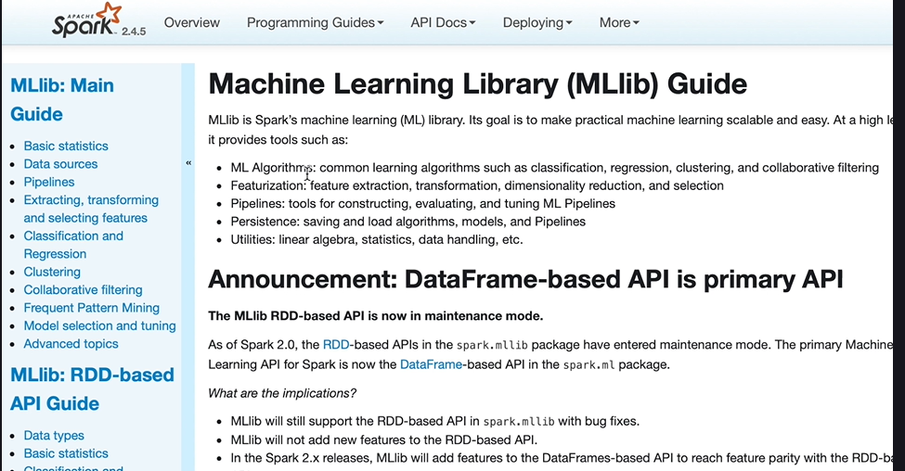
Notes:
1) You can see examples

Slide 4
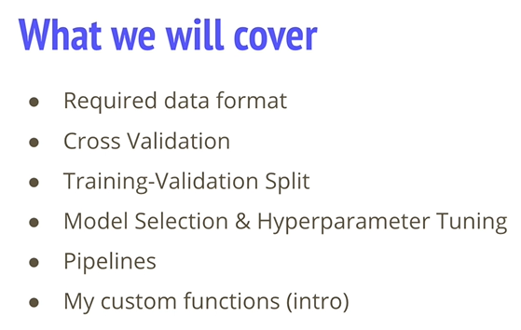
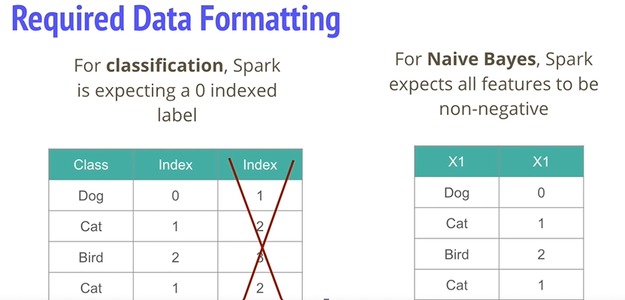
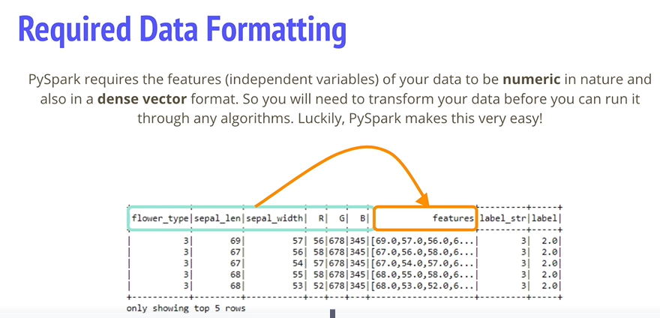
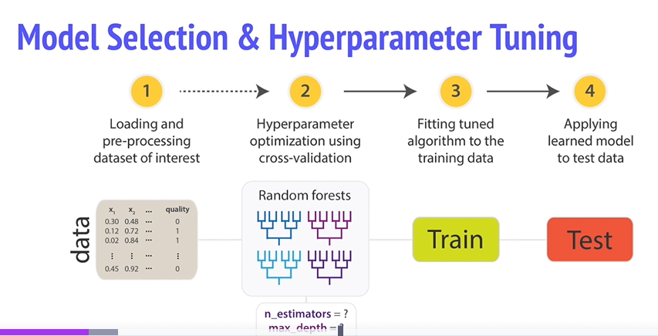
43. Model Selection and tuning.
Notes:
Note the use of her custom Functions
Note the required data format ..frame needs to be in
Need to transform your data into this format (array).
Whatch for custom scripts to featurize. Must name “label” and “features” respectively.
Note Zero based indexing
Can tune the entire pipeline at once

Slide 5
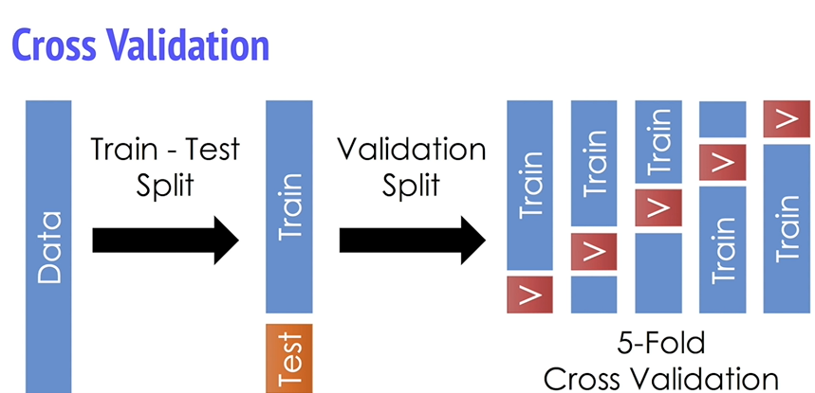
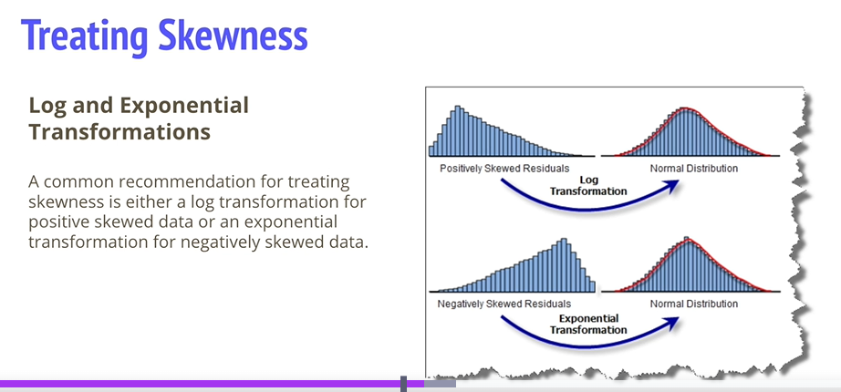
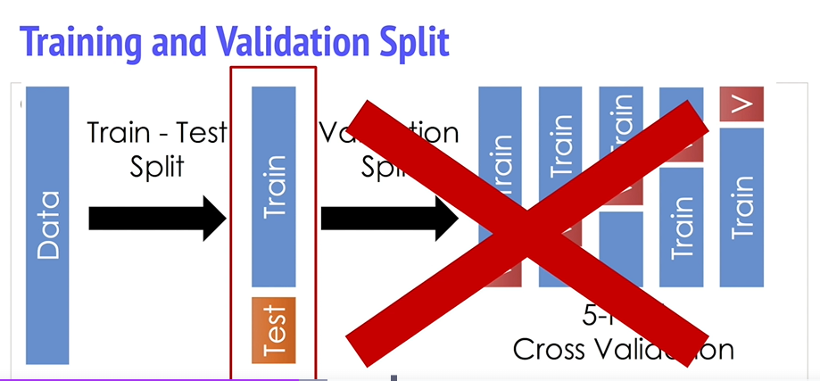
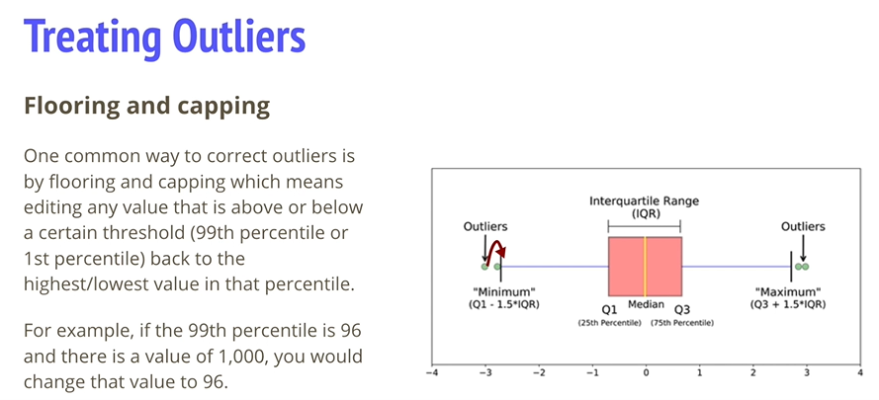
Cross validation
Notes:
Normal cv tunes params individually. 4 fits for training and 1 for test.
Average evaluartion over 5 folds

Slide 6
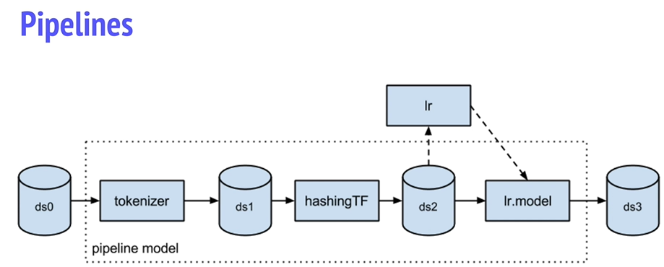
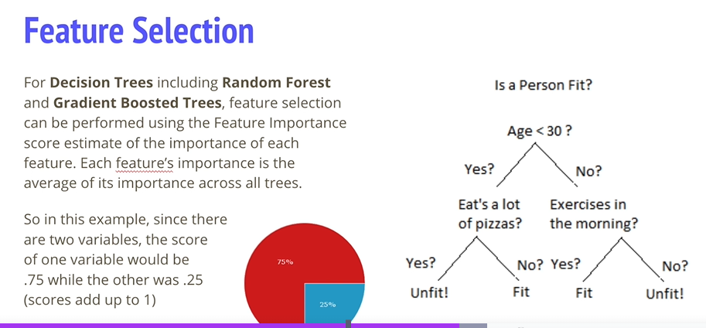
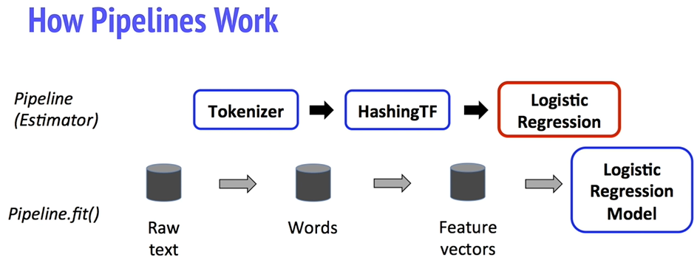
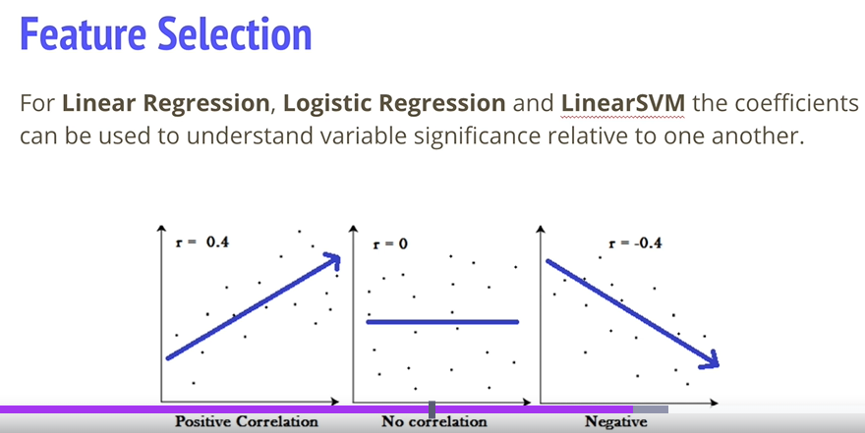
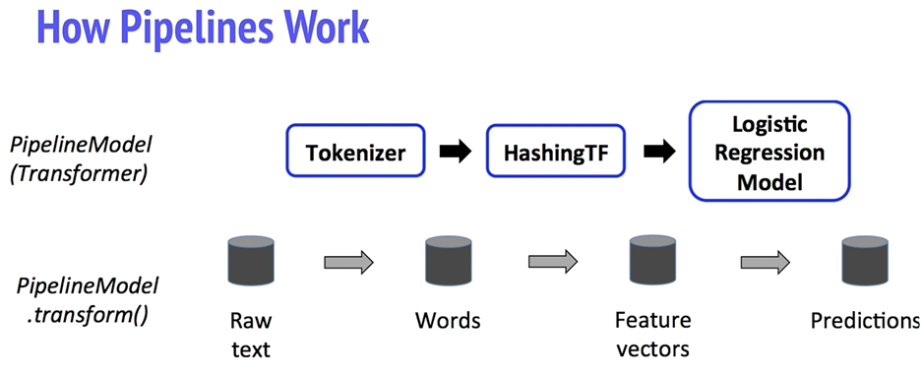
Notes:
ML Pipelines, transformers and estmators
Transformers… transform function , estimators , the fit method/
Tokenizer and Hashing TF , are transformers , log reg is the estimator
After the pipeline runs , it becomes a transformer , and is used to tranfsform the input df top predictions ; the pipeline model is used at test timer.
All estimators in the original pi[eline are now transformers.
Now we have test data , we move through the pipeline.
Pipelines ensure identiocal feature procfessing between train and test data.

Slide 7
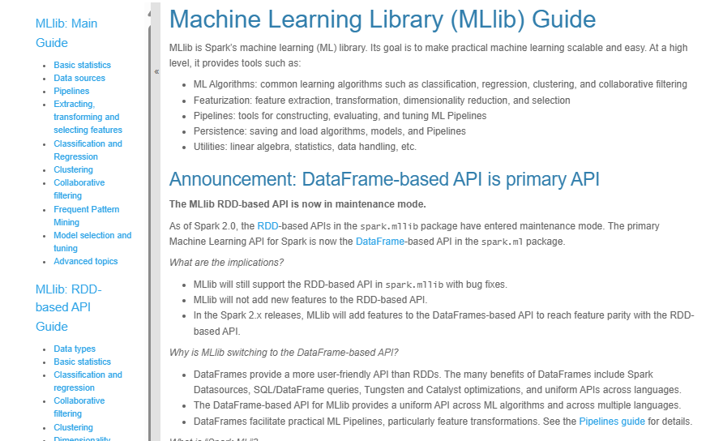
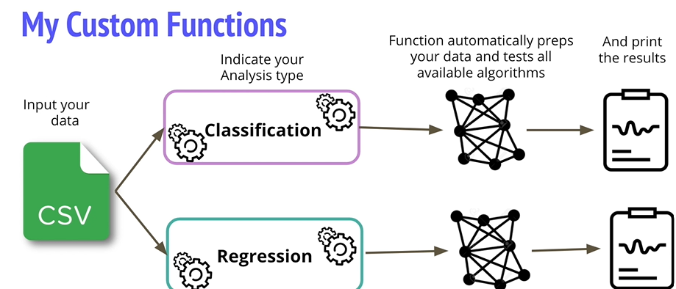

My Custom Functions
https://spark.apache.org/docs/latest/api/python/reference/pyspark.ml.html
https://spark.apache.org/docs/latest/ml-guide.html
Notes:
She has automal functions for us that do the lot.

Slide 8
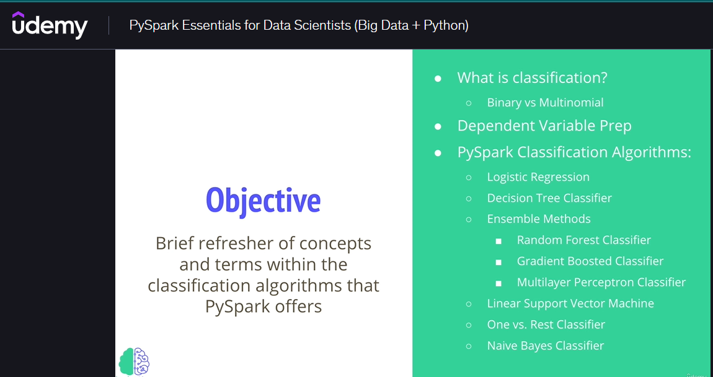
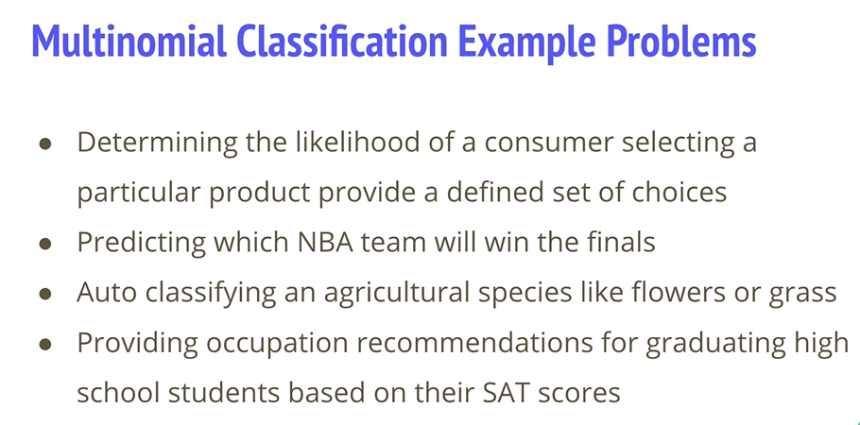
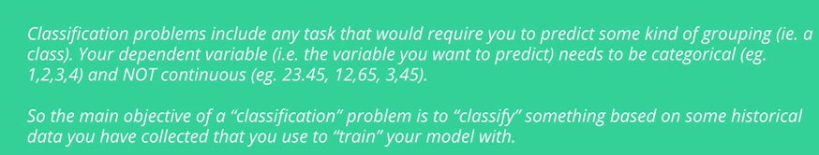
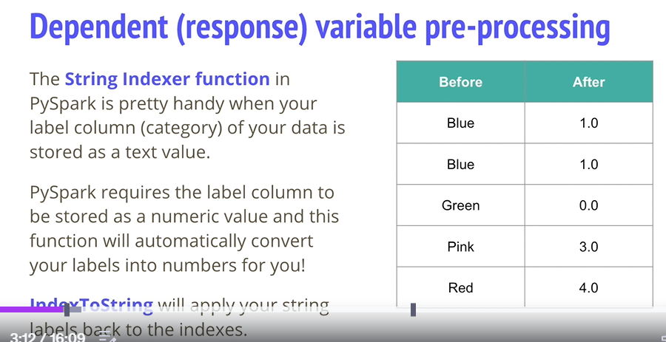
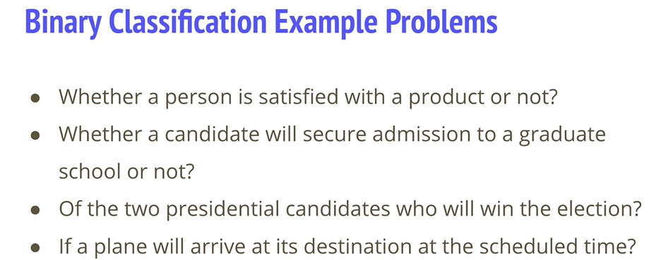
46. Intro to Classification
Notes:
NB , notice the stringIndexer , label col text to numbers
Reverse , apply string labels back to indexes.

Slide 9
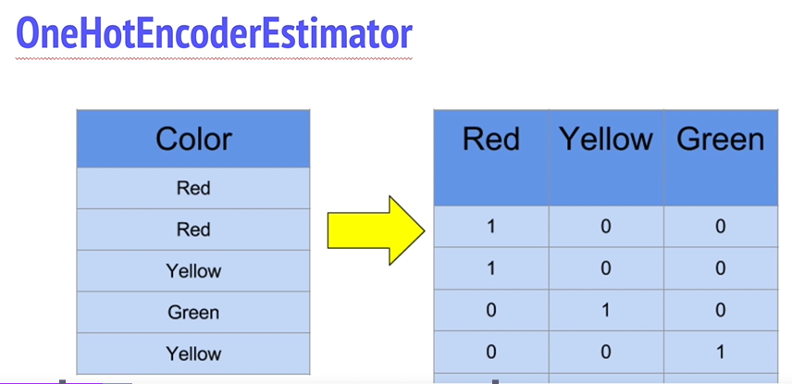
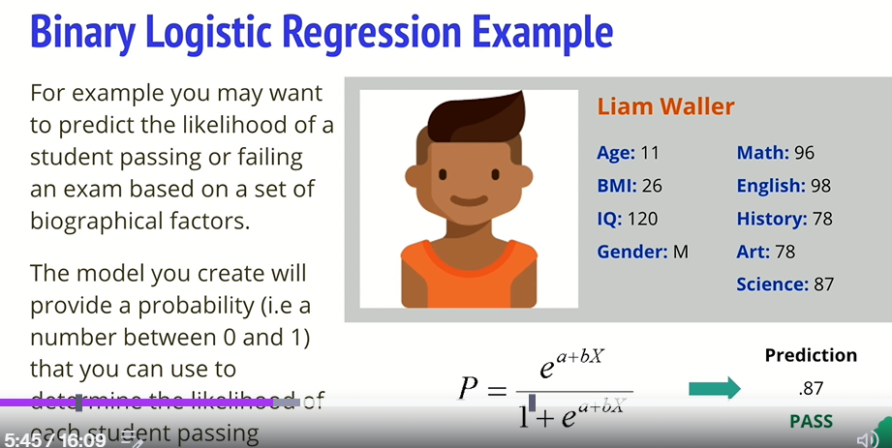
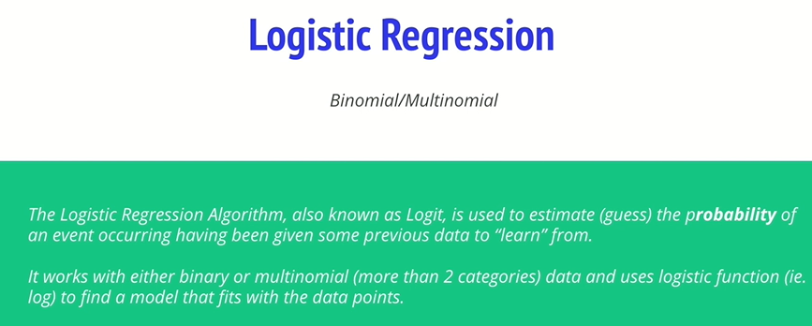
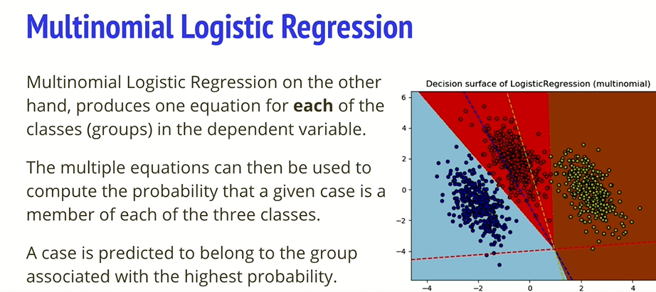
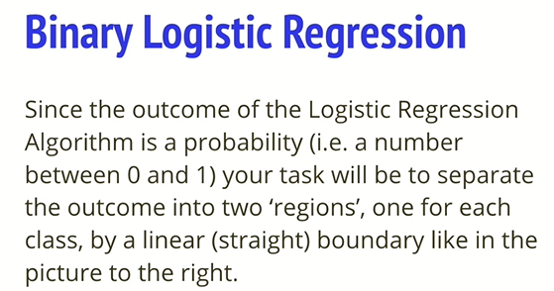
Notes:
Another method to applt string to numbers
Asses probability of event ..

Slide 10
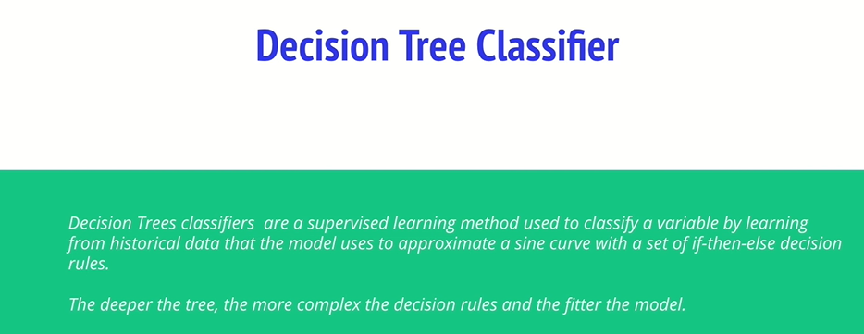
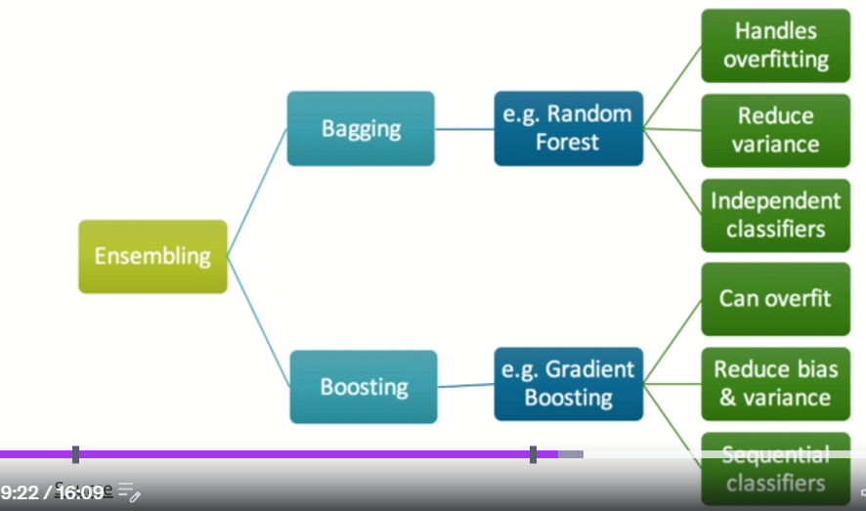
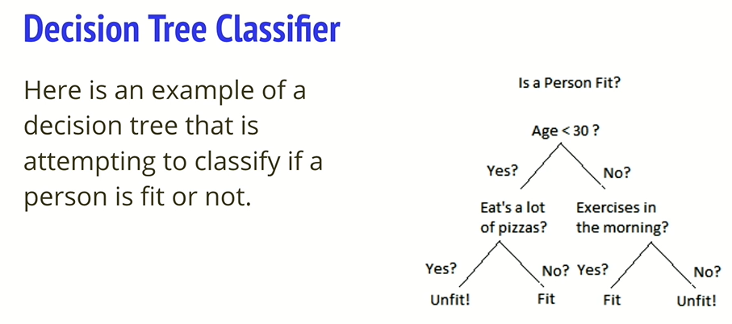
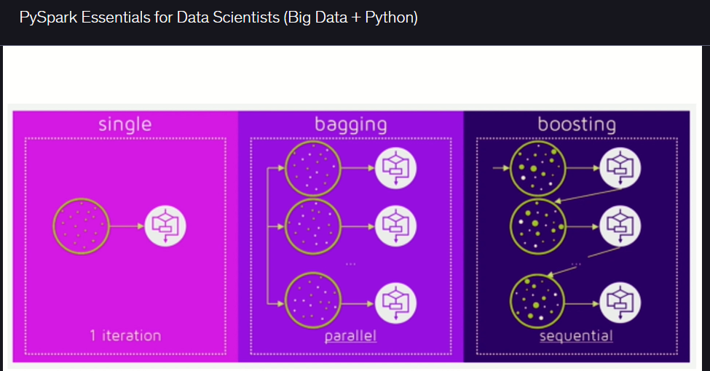
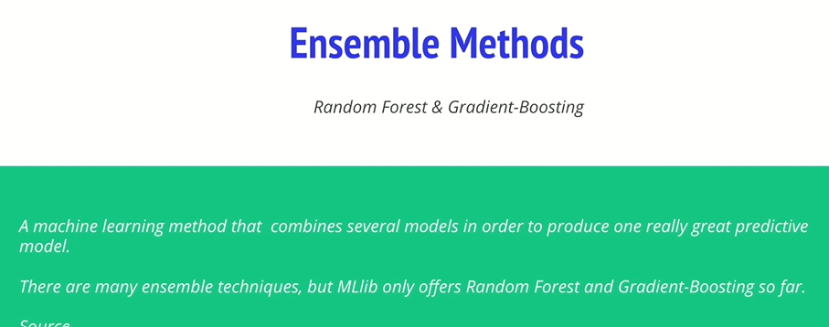
Notes:
Decision Tree high variance
See the nice comparison..
Notice how Boosting reduces Bias and Variance , but Random forest Reduces variance , but random forest handles over fitting , but Boosztin can overfit!
Notice the serial pattern of boosting, and the paral;el nature of bagging.
Bagging.. Parallel , max vote , choice .. Boosting serial on one another.
Boosting , less time to run ..learns from previous errors,

Slide 11
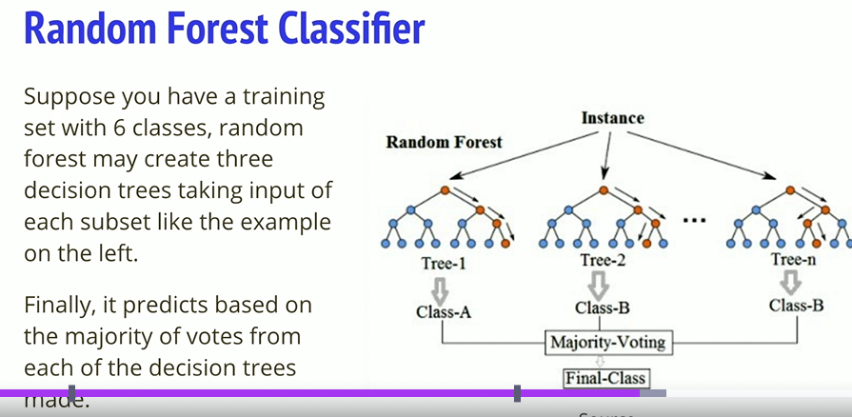
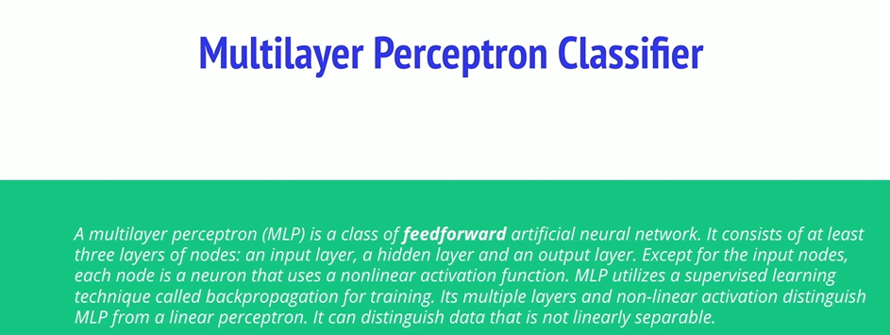
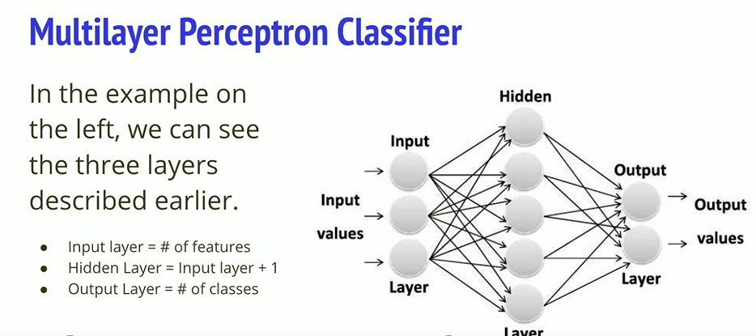
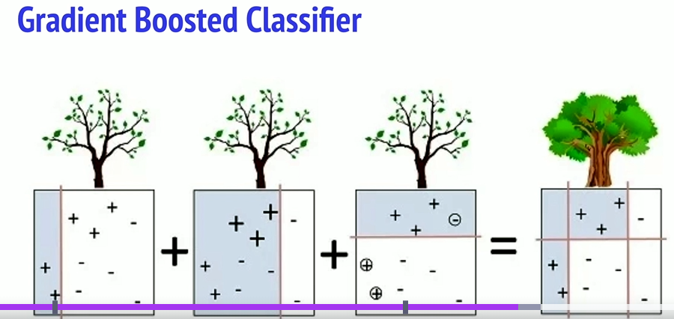
Notes:
Random Forest , majority class. Single tree prone to noise…
Gradient Boosting ..hierarchical approach., weak learners , define loss function and minimize it.
Input layer is the number of features , hidden gives more features , dependent on the previous features.

Slide 12

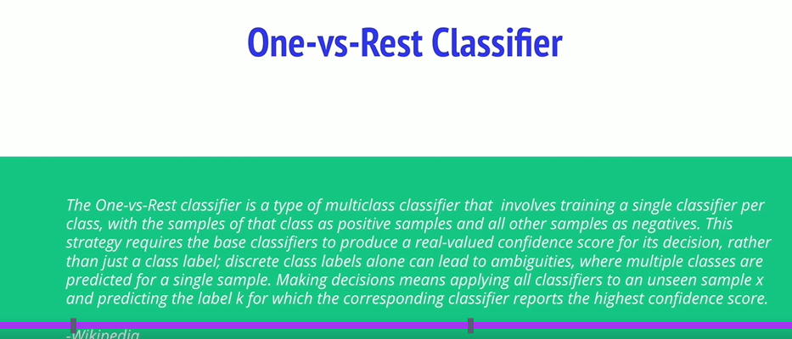
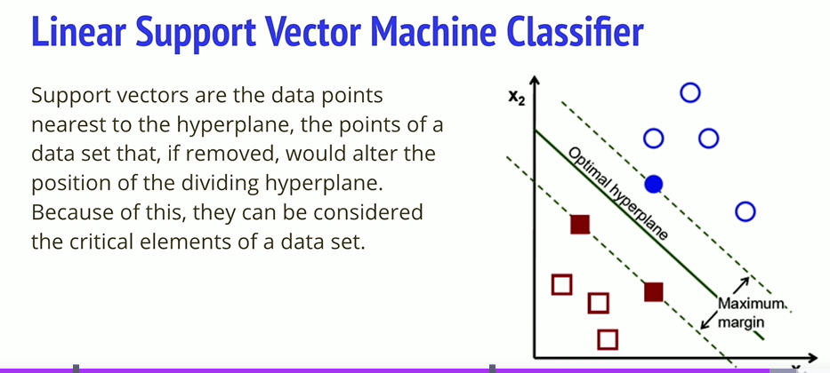
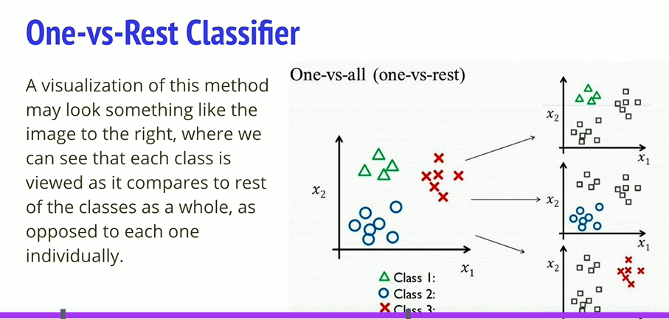
Notes:
1) One versus rest, unbalanced classes.

Slide 13
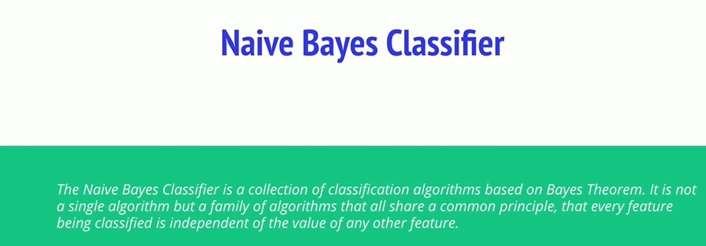
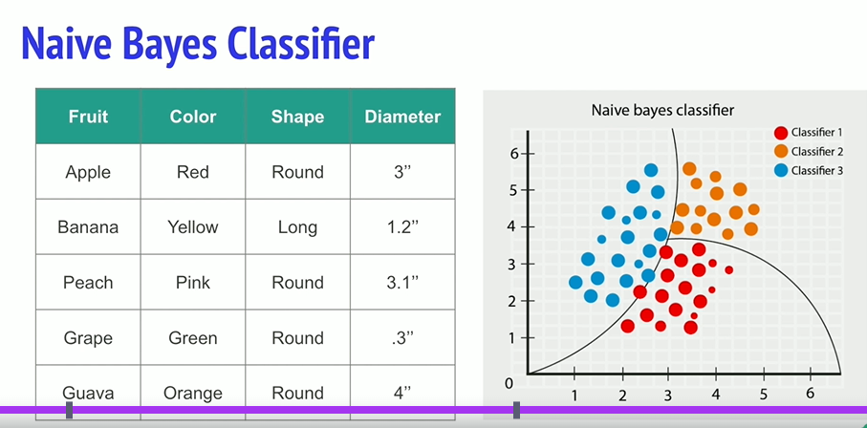
Notes:
Naïve Bayes , a family of algorithms that share a common principle
Each feature considered separatelty, regardless of an correlations between them!

Slide 14
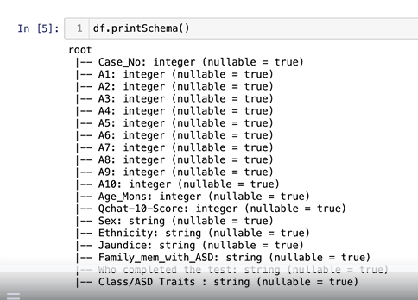
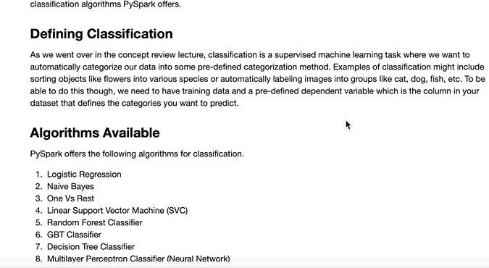
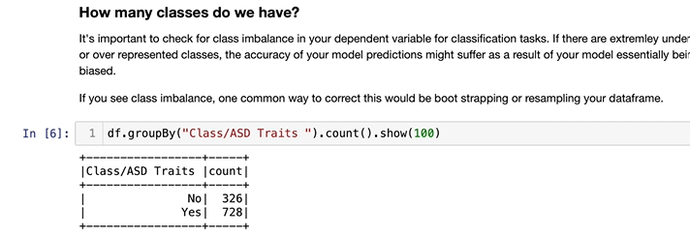
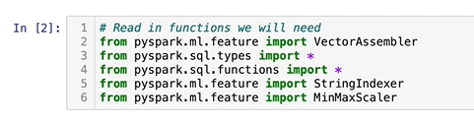
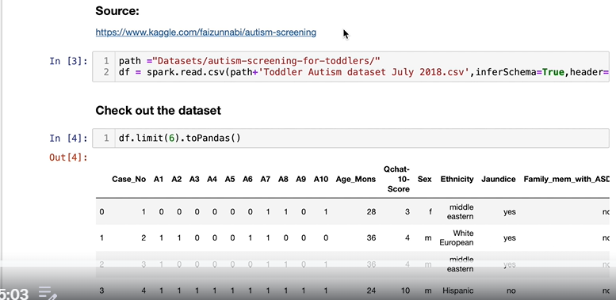

48. Coding Activity – Part 1 – Prep Data
Notes:
Very important to notice the functions we bring in
She goes through all the features..
Must [print out the schema. , we need to recode to numerical features.
Check to see the balance between classes., on the right , may be biased….rectified by bootstrapping or resampling the df.
< 1% would be bad.
Call dependent variable ..label. – do up front; click link under format data …to see material background in formatting data.

Slide 15





Formatting continued:
Notes:
Neeed all cols in list format. , We need a subset…,note the subsetting, not first or last.
Specify dependent variable., and reformat to numeric vars , zero indexed.
Note the use of the string Indexer function , and get the dependent var correct
We have to convert the stringtypesd to numeric of the indep vars
Code above changes the string to numeric
Check the Schema after the conversion to numerixc. To check al done.

Slide 16







Transformation example
Notes:
Makes a dictionary from top and bottom 1%, and correct the shewnees …if its greater than 1.
Take the log of it
When its greater or smaller than cap then at the gretaes and smallest of the 1%
There were no changes for this algorithm, then there was no skewnees
On the right we check for negative values , so wwe can use Naïve Bayes Classifier to the right.
We write code to detect the mins and collect the global minimum .. If that is less than zero. See top right
Df_minimum was > 0, so no zeros , no correction needed
Then we use Vector assembler to compute the feature from the features list (this is a model, or transformer.
We must call the assembler to do the transform.and get an output.
We found no negatives in our df , but Pyspark has a handy function to di this. , see bottom right.
Min,max scaler ..adjust any column to a scalar.
Note sclar is an extimator , therefore scalar .fit / Vector Assmbler is a tranfformer , so here we produce a scaler model.
And we run the datframe through this model. And show the result
Drop the column and renamed the scaled feature to features , for modelling purposes.
Use with ColumnRenamed.. Just to rename columns.
Train test split …
Ready to go modelling

Slide 17

49. Classification Part 2.0 Train and Evaluate(Intro)

Slide 18

Set up some Objects for Evaluation

Slide 19

50. Part 2 Classification: Train/Test [Logistic Regression]
Notes:
See link for more details

